Slide 1
Assignment 1 Hint 1
Web Design and Programming
Week 6

Slide 2
Assignment 1
Submission:
A .zip file that contains all files in your web project. Submit this .zip file on the Canvas site of this unit.
Two usernames and passwords for admin user and registered user.
Late submission: 5% of the total mark (i.e., 1.5 mark) per day. Information on how to apply for extension can be found in the unit outline available on the Canvas site of this unit.
Topic: Website for Industry 4.0 – also known as the fourth industrial revolution – with 6 companies and organisations: IBM, Amazon, Google, Microsoft, CSIRO, and Department of Industry, Science, Energy and Resources, and 6 emerging technologies: Artificial Intelligence (AI), Internet of Things (IoT), Cognitive Computing, Cloud Computing, Robotics, and Blockchains.

Slide 3
Requirements discussed in Week 6
Website:
Full-width layout and responsive design for all web pages.
Home page: to introduce Industry 4.0, the 6 emerging technologies, and 6 web sites about Industry 4.0. Use parallax scrolling and bootstrap carousel sliding techniques. Details are shown below.
Page for companies and organisations: to introduce 6 companies and organisations which are IBM, Amazon, Google, Microsoft, CSIRO, and Department of Industry, Science, Energy and Resources. Details are shown below.

Slide 4
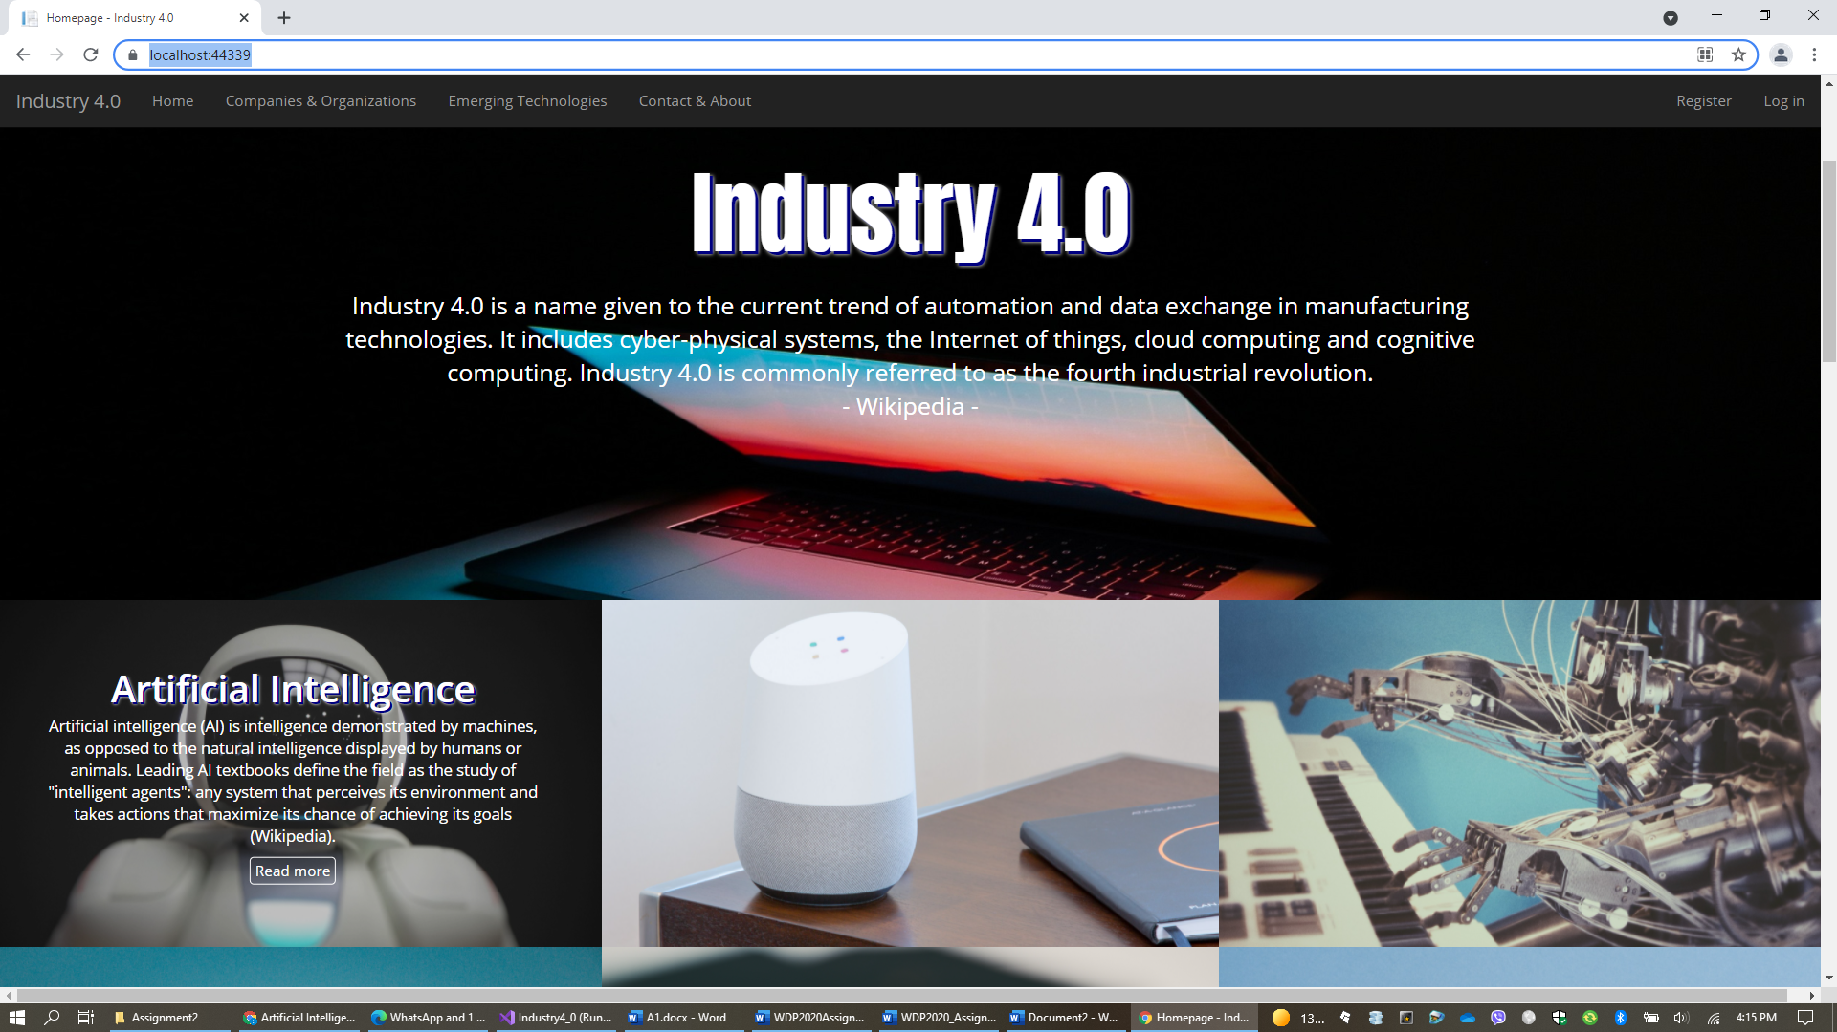
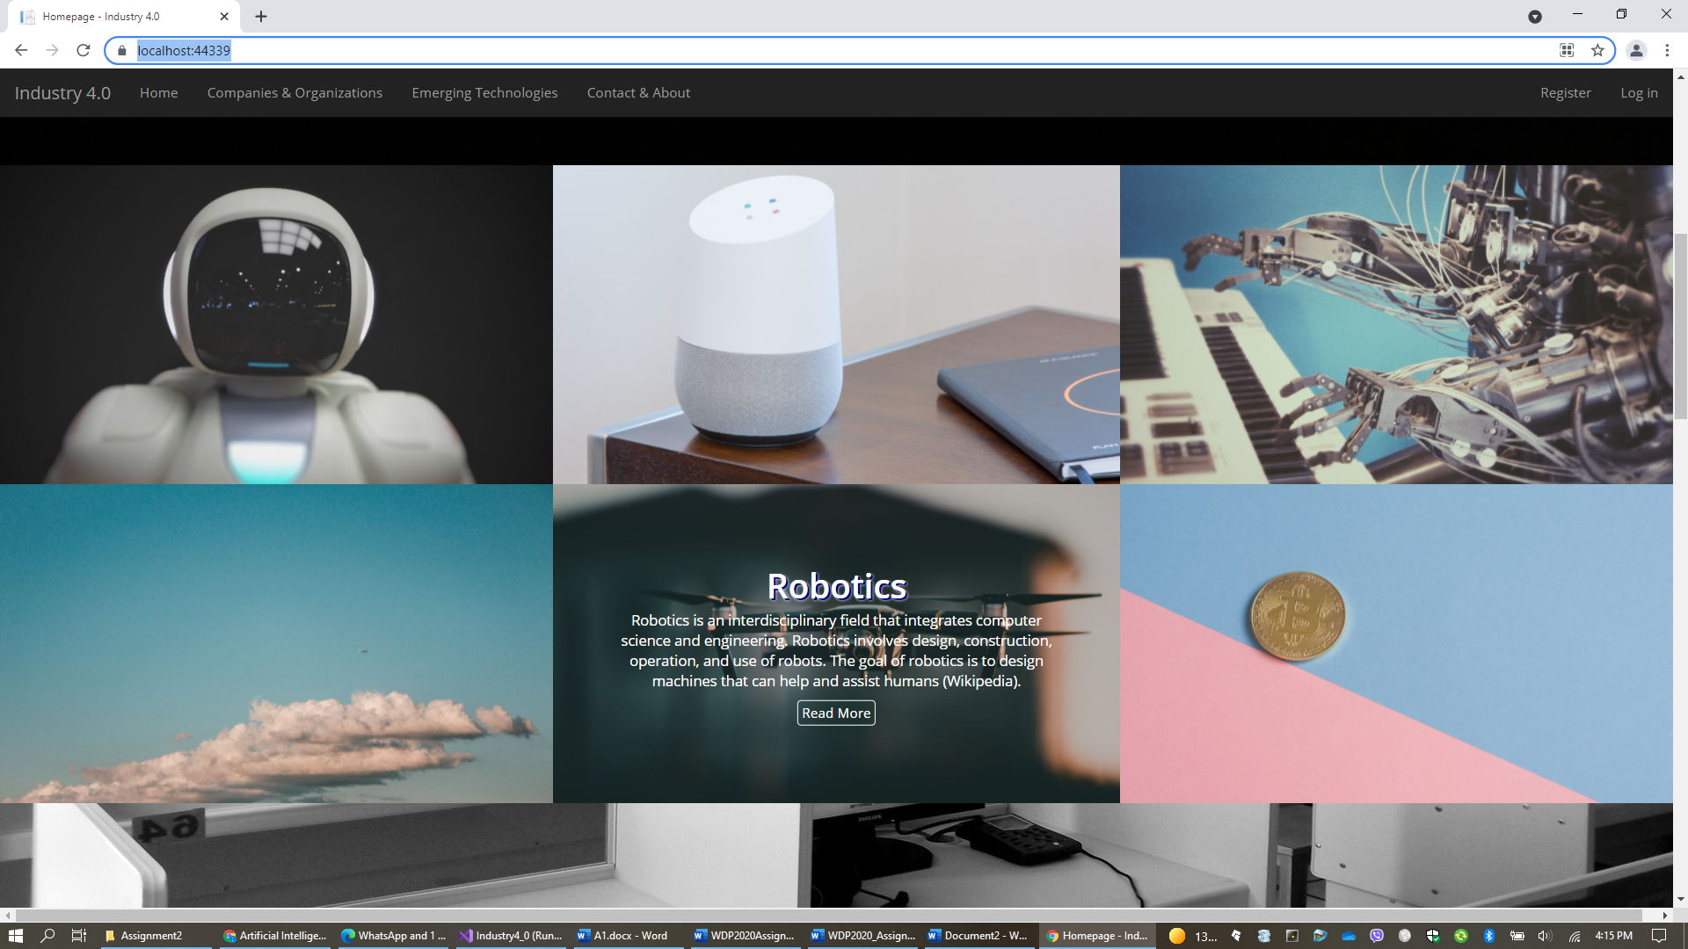
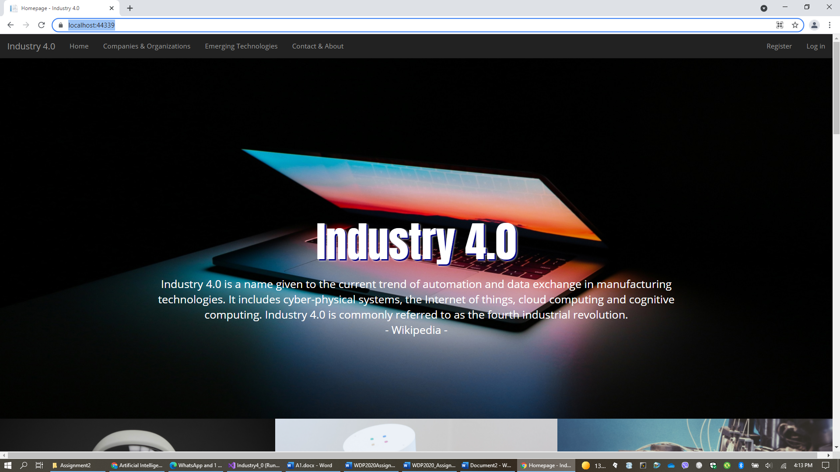
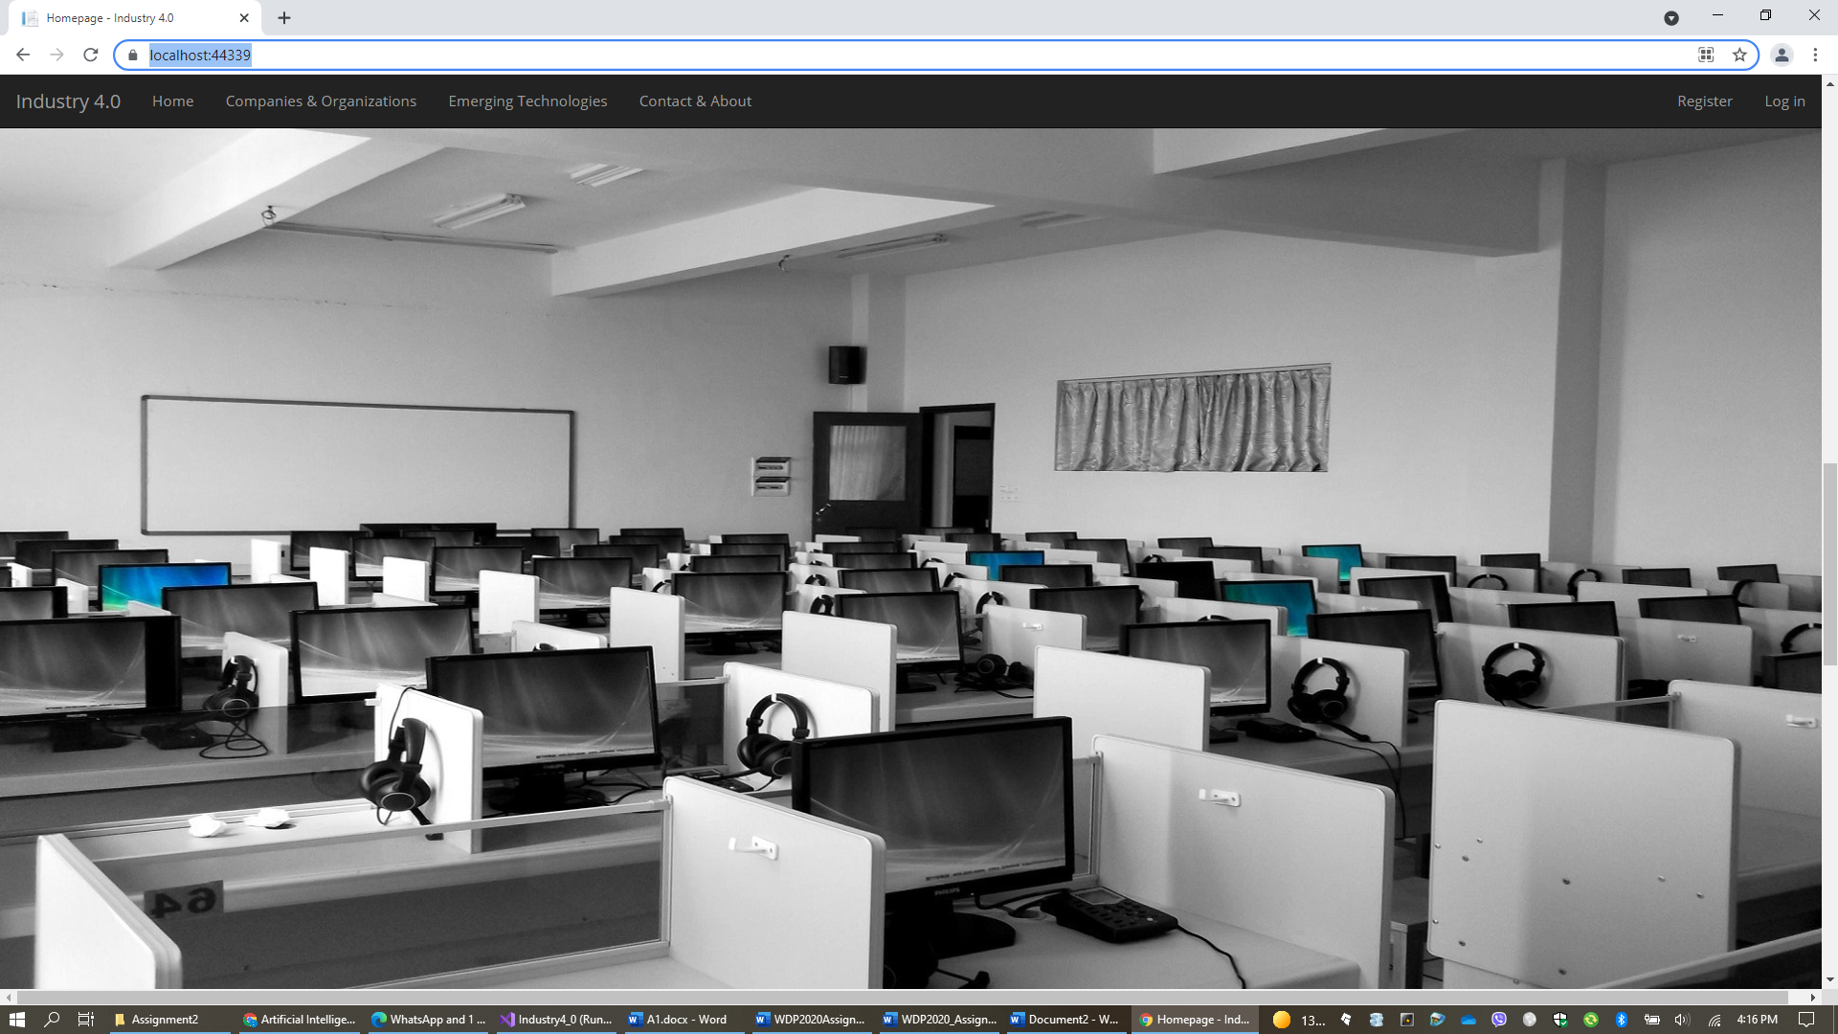
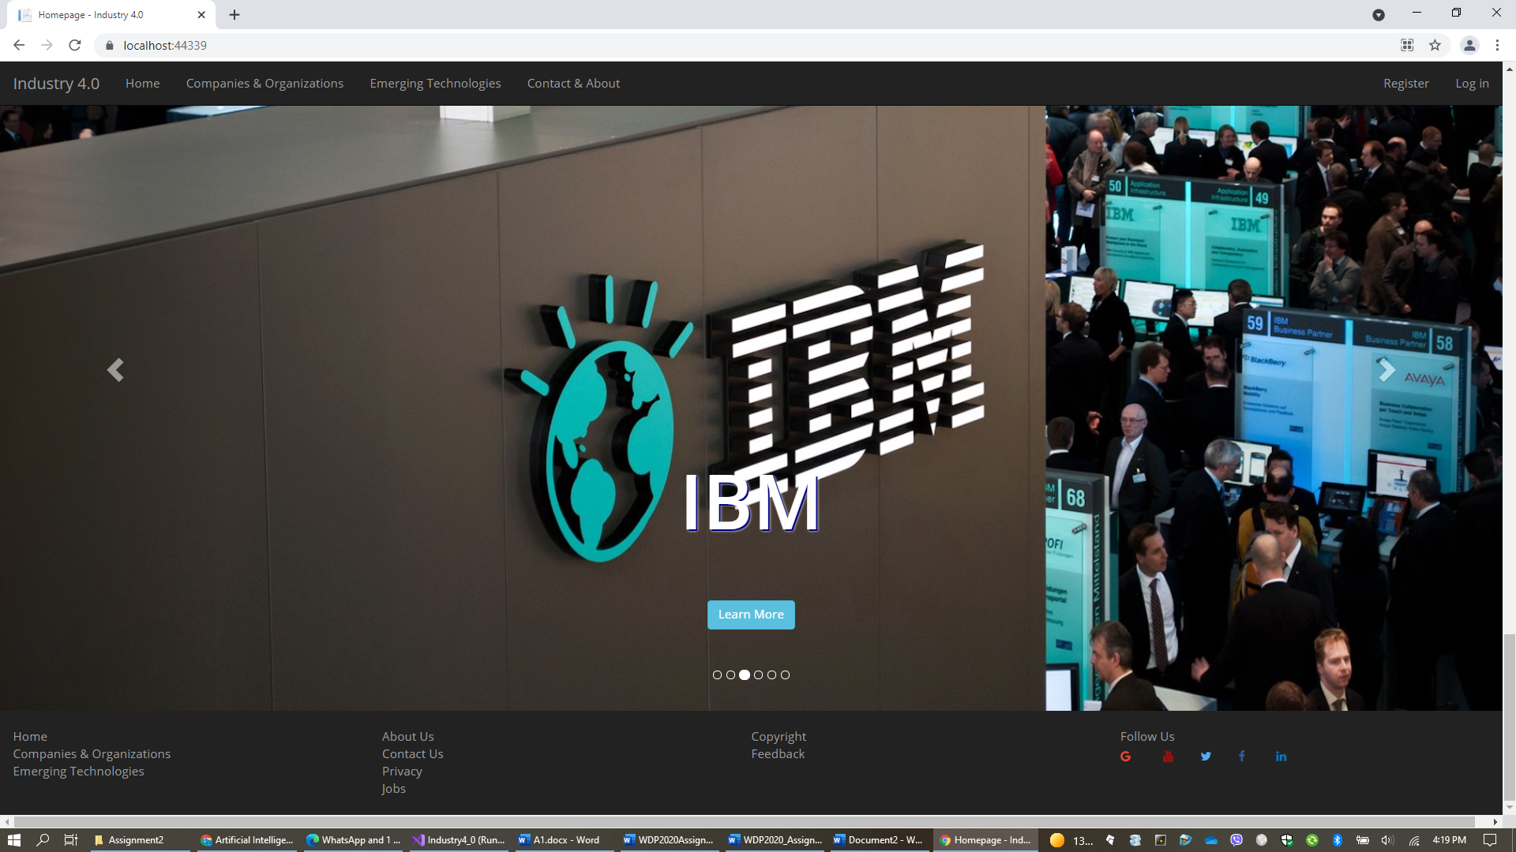
Home Page

Slide 5
Home Page
Navigation bar: found in ASP.NET Core template (Week 6 lecture)
Large header starts here (Anton font from Google)
Mouse enter/out effects for all 6 images (Week 3 tutorial)
Bootstrap carousel sliders (Week 3 lecture)

Slide 6
Home page requirements
Full-width layout
Responsive design
Large header for Industry 4.0
Parallax scrolling with 2 fixed background images
Bootstrap grid layout (3 rows x 2 columns for laptop, 2x3 tablet and 6x1 phone) with 6 images to introduce 6 emerging technologies (Artificial Intelligence (AI), Internet of Things (IoT), Cognitive Services, Cloud Computing, Robotics, and Blockchains)
Large animated sliders using Bootstrap carousel sliding technique to introduce 6 companies and organisations (IBM, Amazon, Google, Microsoft, CSIRO, and Department of Industry, Science, Energy and Resources)
System Design: It would be highly recommended that we separate HTML, CSS and JavaScript/jQuery in order to comply with best practices.

Slide 7
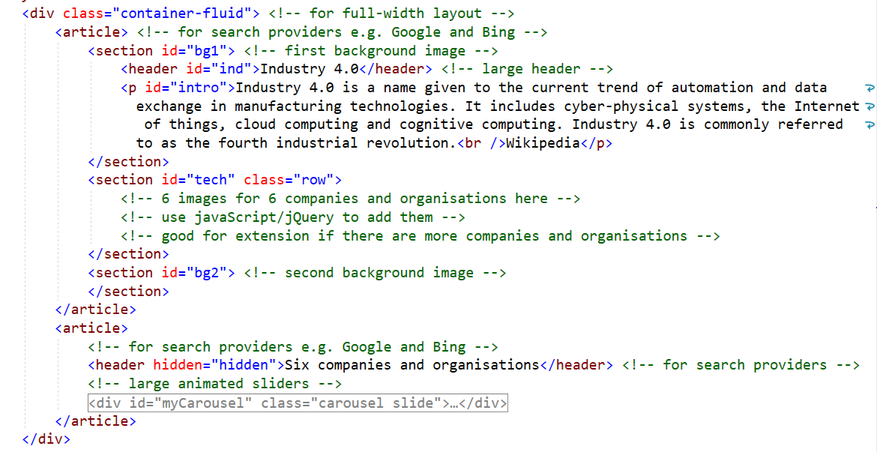
An example for Home page design
Demo in classroom

Slide 8
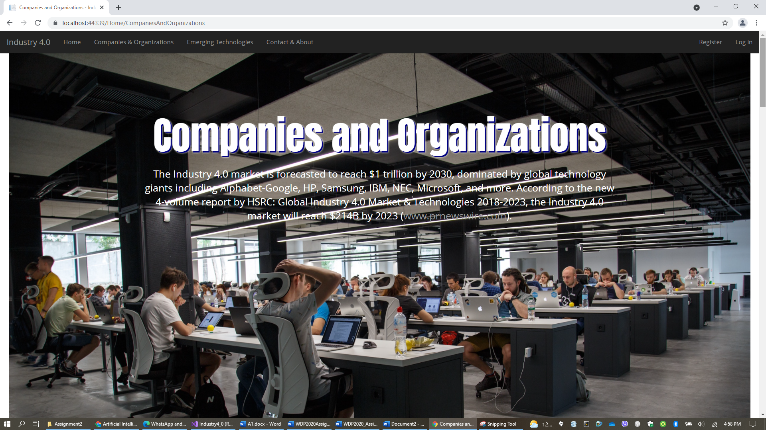
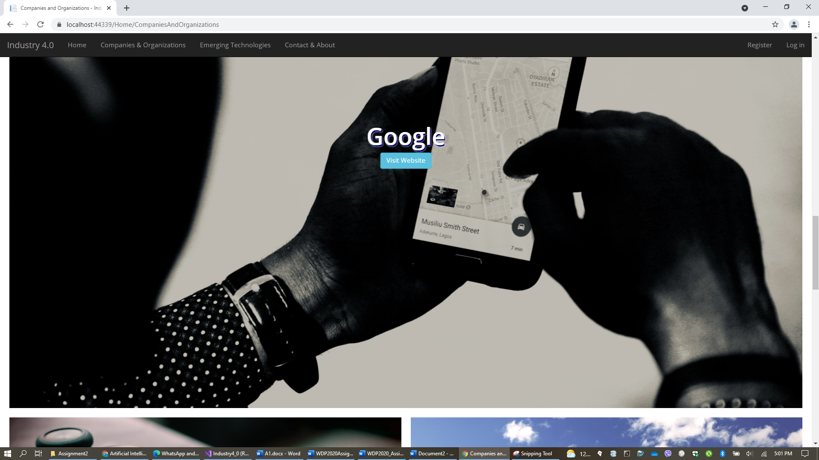

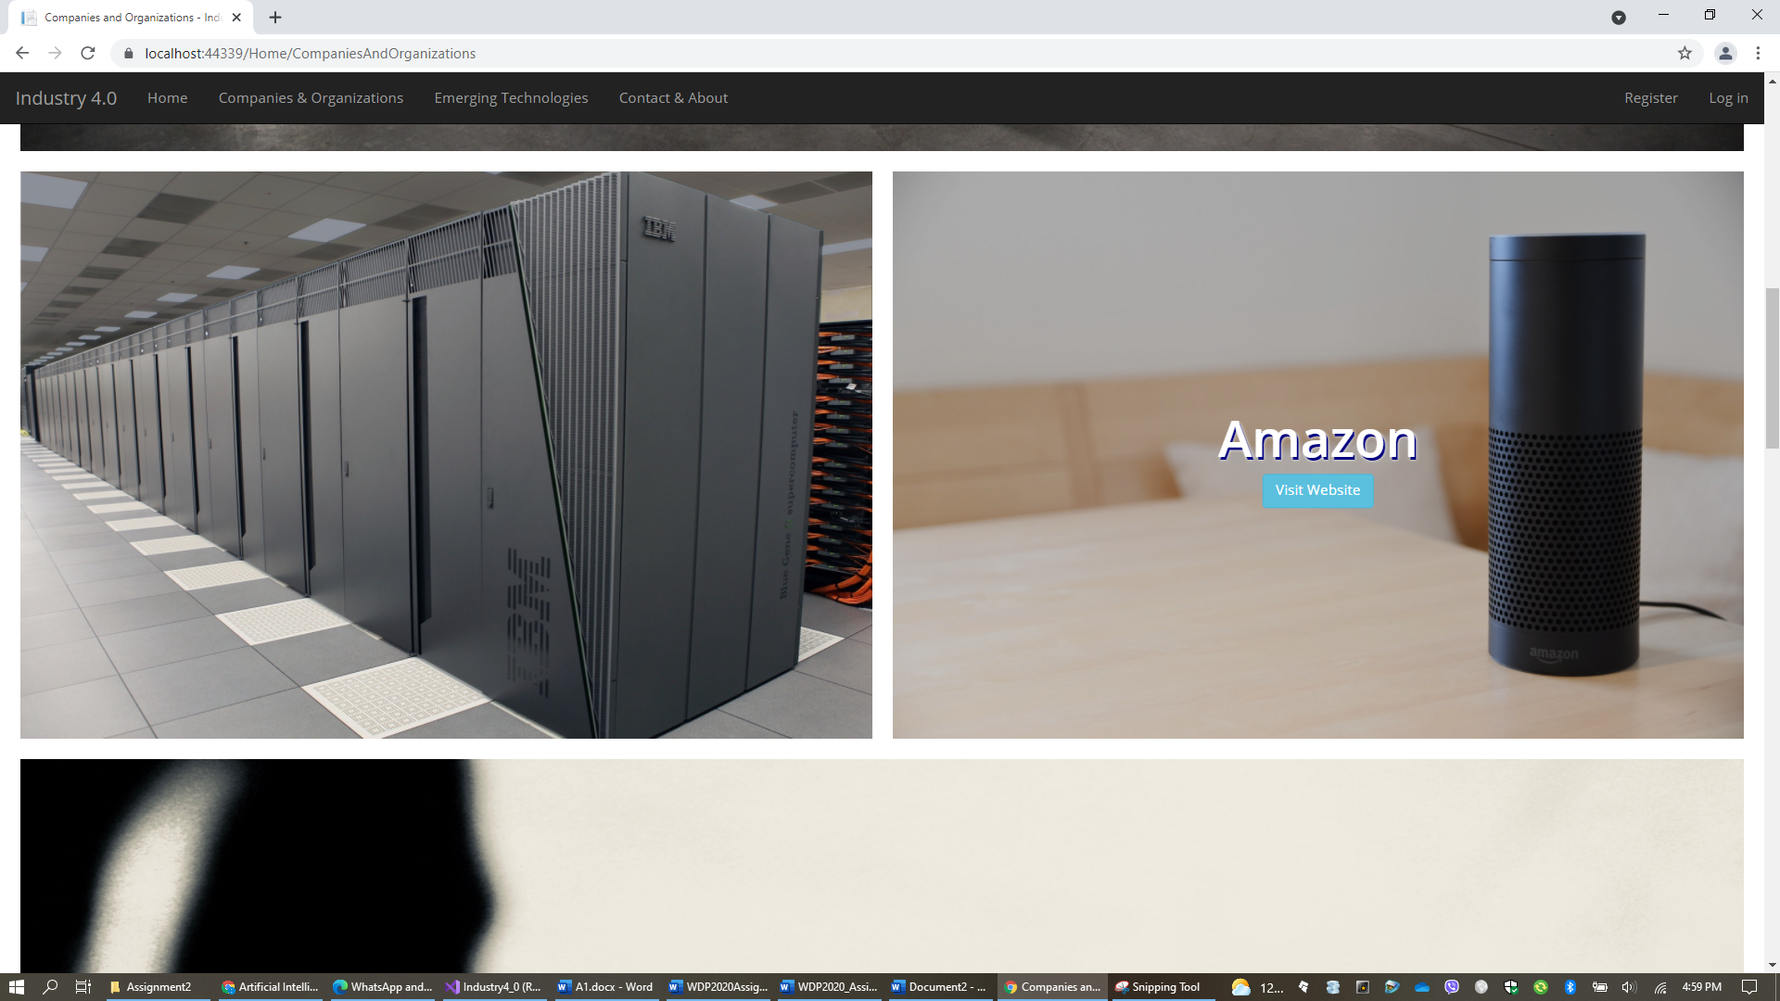
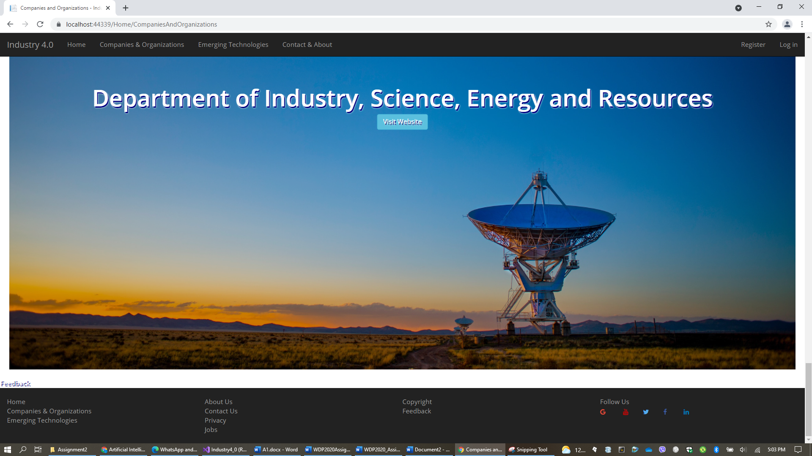
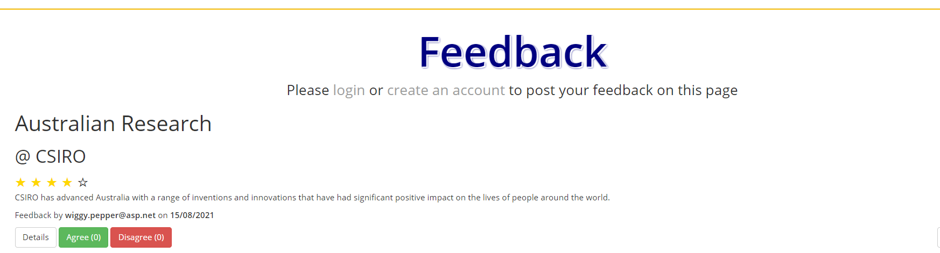
Page for companies and organisations

Slide 9
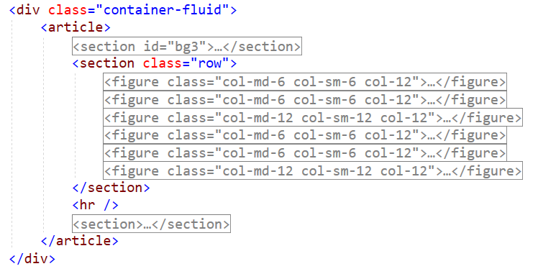
An example for Companies page design
Demo in classroom

